Slide 1

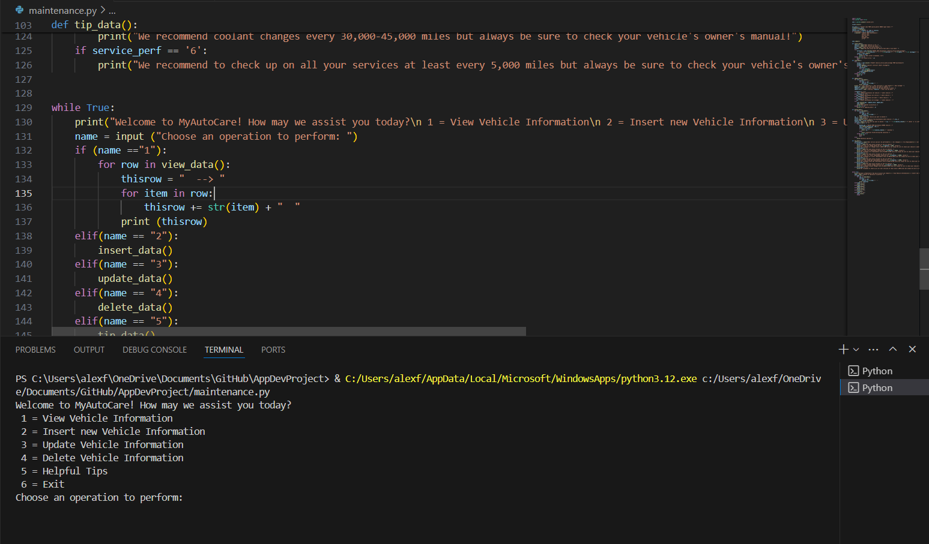
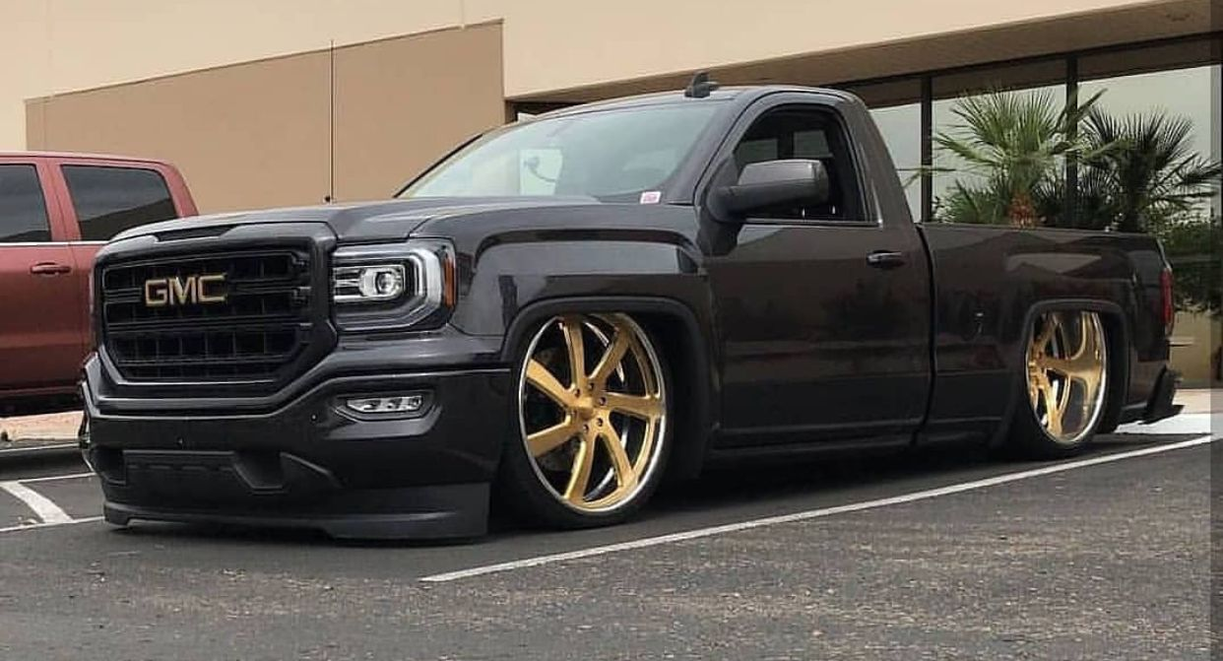
Track your auto maintenance with basic information!
+
Get caring tips/ideas!
MyAutoCare
Don't ignore your car's health! Let me help you with it!
By. Alejandro Frias
ksu-is/MyAutoCare: Auto Maintenance using sqlLite (github.com)

